Slide 1

Department of Computer Science and Engineering IIT KHARAGPUR
DATA ANALYTICS PROJECT
TOPIC – SMART RURAL FARMING ANALYTICS
GROUP NUMBER – 15
AMAN SHARMA (25CS60R330)
RAHUL BASUMATARY (25CS60R13)
ASHISH KUMAR (25CS60R81)

Slide 2
PROBLEM STATEMENT
Farmers often rely on intuition or traditional practices for decision-making, which can lead to:
- Suboptimal crop selection.
- Poor yield due to mismatched soil and climate conditions.
- Income instability due to fluctuating market prices.
- Crop losses due to floods, droughts, and other climate-related risks.
Most available Agri-analytics platforms are designed for large-scale farming in developed regions, not for small/marginal farmers in India. This leaves a gap where data-driven decision support systems for small farmers are missing. A unified data analytics platform can address these issues by providing scientific, data-backed recommendations tailored to the needs of rural farmers.

Slide 3
DATA SOURCES
Weather Data: Rainfall, temperature, humidity (IMD, NASA POWER, or Kaggle datasets).
Soil Data: pH, nitrogen, phosphorus, potassium levels (ICAR, FAO soil databases).
Crop Yield Data: Govt. of India’s Directorate of Economics & Statistics or FAOSTAT.
Market Price Data: Agmarknet (Govt. site for daily mandi prices).
Agriculture Department (IIT KGP): access to local datasets and surveys, soil test data, crop yield statistics, or experimental farm records.

Slide 4
EXPECTED OUTCOMES
A structured dataset combining soil, weather, yield, and price information.
Analytics models for crop recommendation, yield prediction, and price forecasting.
A functional dashboard prototype for decision support.
Potential academic value (publication in data science/agriculture conferences).
Real-world impact by supporting rural farmers.

Slide 5
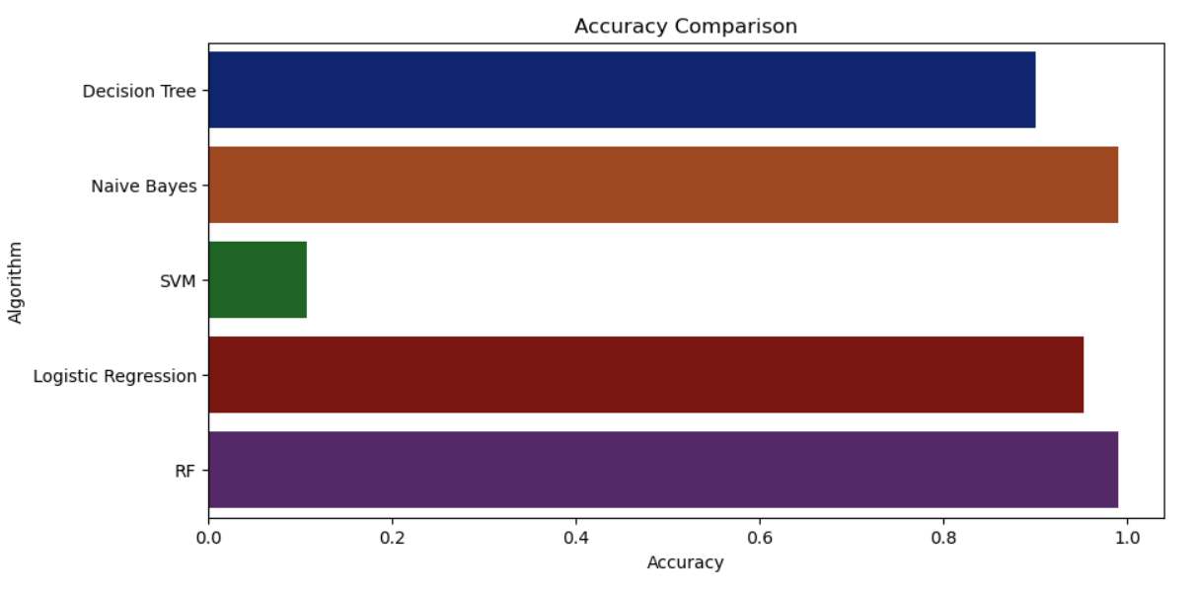
ACCURACY COMPARISION OF DIFFERENT ALGORITHMS

Slide 6
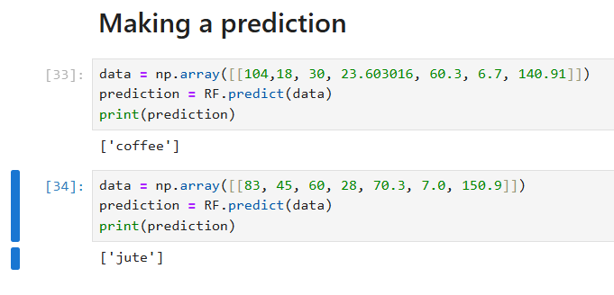
OUTPUT PREDICTION

Slide 7
Thank You

